Slide 1
In The Moment (ITM)
Matt Turek, Ph.D.
Program Manager, Defense Sciences Office
Briefing prepared for: Proposers Day
March 2022

Slide 2
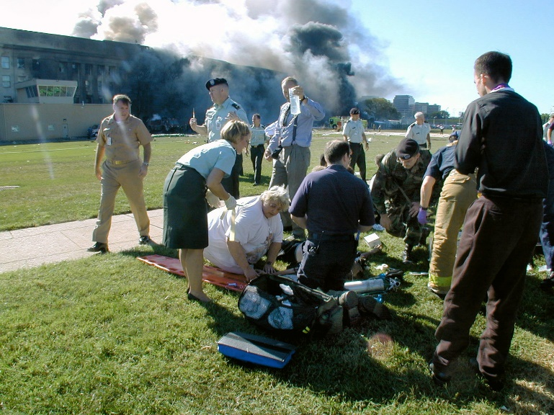
ITM objective
Quantify the alignment of algorithmic decision-makers with trusted humans in difficult domains where there is no right answer.
Enable human-off-the-loop delegation to tactical algorithmic decision-makers
for difficult DoD domains.
ITM Development Domains
Small Unit Triage
Triage for Mass Casualty
https://www.afsoc.af.mil/News/Photos/igphoto/2001868908/
By JO1 MARK D. FARAM, USN - [1], Public Domain, https://commons.wikimedia.org/w/index.php?curid=2152632

Slide 3
Triage for Las Vegas mass casualty shooting
Emergency Physicians Monthly
Decision-making theories
Yates et al.
Serious outcomes
Options – too few, too many
Volume of information – too little or too much
Possibilities – difficult to estimate outcomes
Clarity & value – no clear answer, unsure value of outcomes
Advice – conflicting or contradictory, i.e., humans disagree
Shortland et al.
All courses of action are adverse, high-risk, with negative consequences
Las Vegas scenario challenges (Menes et al.)
Treatment rules conflict
“By textbook standards, some of these first arrivals should have been black tags, but I sent them to the red tag area anyway. I didn’t black tag a single one.”
Policy rules conflict
“And so I turned triage over to a nurse. The textbook says that triage should be run by the most experienced doctor, but at that point what else could we do?”
Menes, Kevin, Tintinalli, Judith, and Plaster, Logan. How One Las Vegas ED Saved Hundreds of Lives After the Worst Mass Shooting in US History, Emergency Physicians Monthly, Nov 3, 2017
Shortland, Neil D., Alison, Laurence J. and Moran, Joseph M. Conflict, How Soldiers Make Impossible Decisions. New York, NY : Oxford University Press, 2019.
Yates, J.F., & Estin, P.A. Decision making. In W. Bechtel & G. Graham (Eds.), A companion to cognitive science. Malden, MA: Blackwell, 1998.
Yates, J.F., & Patalano, A.L. Decision making and aging. In D.C. Park, R.W. Morrell, & K. Shifren (Eds.), Processing of medical information in aging patients: Cognitive and human factors perspectives. Mahwah, NJ: Erlbaum, 1999.
Resource availability conflict
“Around that time the respiratory therapist, said, ‘Menes, we don’t have any more ventilators.’ “
How do you measure & trust decision-making when there is no right answer?

Slide 4
Trust model
Trust: “the willingness of a party to be vulnerable to the actions of another party based on the expectation that the other will perform a particular action important to the trustor, irrespective of the ability to monitor or control that other party.” Mayer et al. 1995
(Kohn et al. 2021, Mayer et al. 1995)
Perceived risk
Factors of perceived trustworthiness
Trust
Risk taking in relationship
Outcomes
Trustor’s propensity

Slide 5
Trust model applied to Las Vegas triage (Dr. Menes)
(Kohn et al. 2021, Mayer et al. 1995)
Menes/nurse alignment?
Menes’ perception of the nurse’s attributes as decision-maker
Trust
Menes decides to delegate, off-the-loop
Outcomes
Menes’ trust propensity

Slide 6
SOTA: Self-driving cars use hard-coded risk scores
Interaction | Risk magnitude
Sideswipe truck | 5,000
Head-on car crash | 20,000
Hit pedestrian | 100,000
Nelson, Gabe. Self-driving cars make ethical choices. Automotive News. [Online] July 13, 2015. https://www.autonews.com/article/20150713/OEM06/307139936/self-driving-cars-make-ethical-choices
https://archive.triblive.com/business/technology/pittsburghs-edge-case-research-can-simulate-self-driving-car-nightmare-scenario/
Design aspects ITM seeks to avoid:
Requiring policy & developer consensus at training time to choose the risk values
Baking in risk values into the training process and resulting algorithm
Inability to adapt to changes in desired behavior or situational guidance

Slide 7
Trust model applied to self-driving car scenario
(Kohn et al. 2021, Mayer et al. 1995)
Unknown driver/car alignment
No ability to characterize self-driving car decision-maker attributes
Trust
Unknown risk taking
Outcomes
Drivers’ trust propensity

Slide 8
ITM – characterization and alignment of algorithmic decision-makers
(Kohn et al. 2021, Mayer et al. 1995)
Algorithmic decision-maker measures predictive of end-user trust
Decision-maker alignment score (TA1)
Decision-maker characterization (TA1)
Trust
Aligned algorithmic decision-maker (TA2)
Outcomes
Trusted algorithmic decision-makers adaptable to key human decision-makers for scenarios where there is no right answer
Evaluation techniques to characterize algorithmic decision-makers in difficult domains
Existing trust measures

Slide 9
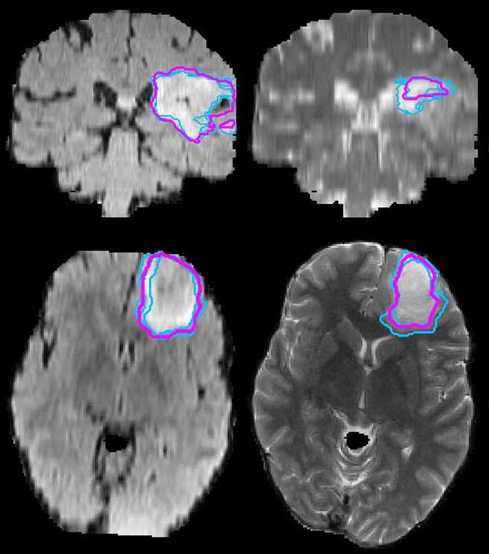
Inspiration: Distributional measures for evaluating medical image segmentation where there is no ground truth
Radiologist segmentation (multiple)
The Multimodal Brain Tumor Image Segmentation Benchmark (BRATS).
Menze, Bjoern H., et al. 10, : IEEE Transactions on Medical Imaging, 2015, Vol. 34
Fused (consensus) segmentation
Difference between blue and purple contours illustrates a significant amount of radiologist disagreement
Distributional measures assess whether an algorithm boundary lies within the distribution of boundaries drawn by radiologists
If an algorithm’s boundary is within the distribution of radiologist boundaries over many trials, the algorithm is considered to have comparable performance to a radiologist

Slide 10
Notional decision maker characterization framework
TA1
Distribution estimation
Alignment: 0.83
comparison
Alignment: 0.1
Decision-maker descriptors
Maximize/Satis
Decision-maker descriptor
Risk tol / aver
Descriptor computation
Reference decision-maker attribute space
Descriptor computation
Responses
Responses
Algorithmic decision-maker under test
Trusted, reference human decision-makers
Scenario probes
Scenarios include complex, multi-step decisions and are designed to elicit responses that characterize a decision-maker.
Scenario & probe design

Slide 11
TA1: Decision-maker characterization
Challenges
Create computational representations of decision-makers (i.e., descriptors) that summarize decision-maker attributes for a domain
Design sampling techniques (i.e., probe design) that cover a decision-making domain and extract key human decision-maker attributes
Develop distributional representations over decision-maker attributes that capture the variability across decision-makers
Create techniques for quantitatively comparing an individual decision-maker against a reference distribution of decision-makers
Correlating characterization techniques with human trust
Strong proposals will:
Describe a decision-making theory for difficult decisions
Define a space of key decision-maker attributes
Consider the impact of situational information, domain knowledge, and other contextual elements on decision-maker attributes and how that may affect decision-maker preferences
Create difficult decision-making scenarios with multiple probes that elicit decision-maker responses that provide insight into their decision-maker attributes
Develop a scenario design process
Identify human decision-makers with relevant expertise
Represent decision-maker responses to scenarios and probes in a computational framework
Compute a reference distribution over decision-maker attributes
Compare a decision-maker under test to a reference distribution of trusted humans to compute a quantified alignment score between the test decision-maker and the reference distribution
Provide for compute needs

Slide 12
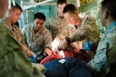
Notional alignment approach for an algorithmic decision maker
TA1
Alignment Approach
TA2
Distribution estimation
Alignment: 0.83
comparison
Find a function f that minimizes task objective function V subject to the regularization constraints R
Alignment: 0.1
Decision-maker descriptors
Maximize/Satis
Decision-maker descriptor
This Photo by Unknown Author is licensed under CC BY-SA
Risk tol / aver
Situational constraints
Decision-maker attributes
Descriptor computation
Reference decision-maker attribute space
Descriptor computation
Responses
Responses
Algorithmic decision-maker under test
Aligned algorithmic decision maker
Trusted, reference human decision-makers
Decision-maker attributes can be treated as a regularizing term, balancing situational constraints with preferred decision-maker traits
Fits into optimization formulations, used in many AI systems
Other formulations, e.g., Bayesian prior on decision-maker attributes, are possible
Scenario probes
Scenarios include complex, multi-step decisions and are designed to elicit responses that characterize a decision-maker.
Scenario & probe design

Slide 13
TA2: Human-aligned algorithmic decision-makers
Challenges
Algorithmic decision-makers that can balance situational constraints with trusted human decision-maker attributes
Algorithmic decision-makers that can be tuned to a group of trusted human decision-makers or fine-tuned to a trusted individual decision-maker
Effective integration of high-level goals and guidance (DoD policy, ROEs, commander’s intent) into algorithmic decision-makers
Strong proposals will:
Describe how they will build decision-making algorithms with quantifiable alignment to trusted human decision-maker attributes
Describe how to tune an algorithmic decision-maker
Describe how to incorporate domain knowledge
Describe required elements for computational representations of scenarios, probes, and scenario context
Describe the TA2 requirements for the program-wide standard interface and API
Provide for compute needs
Describe how their systems will extend to allow open-ended answers to scenarios/probes by the end of Phase 2
ROE – Rules of Engagement

Slide 14
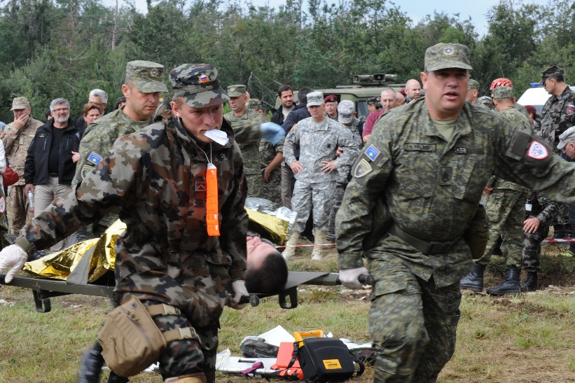
Difficult decision-making domains
Small unit triage
Triage for mass casualty
Disaster relief
https://www.afsoc.af.mil/News/Photos/igphoto/2001868908/
By JO1 MARK D. FARAM, USN - [1], Public Domain, https://commons.wikimedia.org/w/index.php?curid=2152632
This Photo by Unknown Author is licensed
under CC BY-SA
SOCOM
III MEF
Army MEDCOM
Law enforcement
COCOMs
Elements of complexity
(min-hr) Increasing event duration (days-weeks)
(triage has well-structured rules) Less defined rules (every disaster is unique)

Slide 15
Evaluation domains for ITM
ITM focus
Small unit triage
Triage for mass casualty
Disaster relief
By JO1 MARK D. FARAM, USN - [1], Public Domain, https://commons.wikimedia.org/w/index.php?curid=2152632
https://www.afsoc.af.mil/News/Photos/igphoto/2001868908/
This Photo by Unknown Author is licensed
under CC BY-SA
Phase 1
Phase 2
COCOMs
Elements of complexity
(min-hr) Increasing event duration (days-weeks)
(triage has well-structured rules) Less defined rules (every disaster is unique)

Slide 16
ITM evaluation – characterization, alignment and trust
(Kohn et al. 2021, Mayer et al. 1995)
Perceived Risk
Decision-maker alignment score (TA1)
Factors of Perceived Trustworthiness
Trust
Risk Taking in Relationship
Decision-maker characterization
(TA1)
Aligned algorithmic decision-maker (TA2)
Outcomes
Behavioral
Physiological
Trustor’s propensity
Algorithmic
Self-report
Best-practice is to use multiple classes of measures to assess trust and to use pilot-studies before evaluation
Self-report, physiological, & behavioral are three classes of measures commonly used to evaluate trust
ITM will utilize behavioral, self-report, & algorithmic measures to evaluate algorithmic decision-makers

Slide 17
Preliminary behavioral evaluation measure
A behavioral measure used to quantify the willingness of a human to delegate decision-making to an algorithm
ITM performance will depend on both TA1 characterization process and TA2 alignment process
Decision-makers
Aligned ITM algorithmic decision-maker
This Photo by Unknown Author is licensed under CC BY-NC
Responses
Which decision-maker would triage professionals delegate to?
Preliminary success criteria
Delegation to aligned algorithmic decision-maker:
>60% of time (Phase 1)⁺
>85% of time (Phase 2)*
Test scenarios & probes
Baseline algorithmic decision-maker
This Photo by Unknown Author is licensed under CC BY-NC
Responses
⁺ Triage accuracy for US nurses 58.7% – 61.3% (Martin et al. 2014, Mistry et al. 2018)
* Best reported triage accuracy by nurses, meta-analysis 82.9% (Tam et al. 2018)
Multiple triage professionals blinded to source of responses
Triage professional (experimental control)
Responses

Slide 18
Preliminary self-report evaluation measure
Supports the goal that the alignment score serve as a proxy for delegation trust.
1
Intraclass correlation
TA1 alignment score
(continuous)
https://en.wikipedia.org/wiki/Intraclass_correlation
0
1
2
3
4
5
Trust score from self-report human-autonomy trust scale (discrete, Likert)

Slide 19
Preliminary algorithm measure evaluation
TA2 must demonstrate the ability to align their algorithmic decision-makers with a target region of attributes
Phase 1: Within the space of the largest human cluster’s attributes
Phase 2: Within the space of an individual human’s attributes
Target alignment zone (Phase 1)
Target alignment zone (Phase 2)
Size of largest human cluster
(Group alignment)
Maximize/Satis
Size of a individual human
(Individual fine-tuning)
Risk tol / aver
Initial algorithmic decision-maker

Slide 20
Preliminary metrics & goals
Technical Area | Mission Need | Measurement | Phase 1 | Phase 2
Joint TA1 & TA2 | Trusted algorithmic decision-makers for scenarios where there is no right answer | Behavioral measure of triage professional delegation to an ITM aligned algorithmic decision-maker | 60%⁺ delegation preference over baseline algorithmic decision-maker | 85%* delegation preference over baseline algorithmic decision-maker
TA1: Decision-maker characterization | Algorithmic decision-maker measures that are predictive of end-user trust | Intraclass correlation coefficient (ICC) of ITM alignment measure with a human trust scale | 0.3# | 0.5#
TA2: Human-aligned algorithmic decision-makers | Algorithmic decision-makers adaptable to key human decision-makers | Ability to tune algorithmic decision-maker into a subset of the attribute space | Within the largest cluster of human attributes | Within a single human’s attributes
⁺ Triage accuracy for US nurses 58.7% – 61.3% (Martin et al. 2014, Mistry et al. 2018)
* Best reported triage accuracy by nurses, meta-analysis 82.9% (Tam et al. 2018)
# Medium correlation scores for trust measures range from 0.25 to 0.4, with strong results above 0.4 (Hancock 2021)

Slide 21
TA3: Evaluation
Challenges
Develop evaluation protocols, requirements, and metrics for decision making in difficult domains
Scenario and probe environment design that allows for algorithmic decision-maker data collection and psychological fidelity for human decision-makers
Domain knowledge selection and preparation to provide a control for algorithmic decision-maker knowledge
Identify trusted decision-makers for reference decision-maker pool
Strong proposals will:
Identify one or more trust scales that will be used to evaluate TA1 alignment score
Provide a plan for supplying trusted human decision-makers as part of the evaluation process
Identify key confounding variables in the evaluation and describe how they will be controlled for in the evaluation design and execution
Identify a scenario environment or multiple scenario environments that will be provided to the program
Describe the aspects of psychological fidelity that are important for difficult decision-making and how those aspects are supported by the planned scenario environment(s)
Demonstrate expertise with HSR and provide a draft HSR protocol that supports the program evaluations
Provide a plan for executing capstone demonstration events at the end of each phase

Slide 22
TA4: Policy and practice integration
Motivation
Long-term success depends in part on acceptance by the larger policy community
Early integration of policy and practice considerations, especially around ethics, legal, and social implications (ELSI), will benefit developers
Policy and practice subject matter experts can provide relevant expertise without being bound by current practice
Strong proposals will:
Provide evidence of significant expertise in DoD policy, responsible AI, and ethical AI challenges
Provide a plan for supporting ELSI panels and for leading ITM’s DevEthOps
Describe a plan for outreach to the DoD and other communities, listing specific organizations and communities that will be a priority for outreach events
Provide a plan for developing a certification model for algorithmic decision-makers for triage
Demonstrate that the proposed team has the expertise necessary to create a certification model
Challenges
Ground program approaches in DoD policy and practice
Support the development of future DoD-relevant policy & CONOPs
Provide expertise on DoD policy, doctrine, and military decision-making
Developing a certification model for algorithmic decision-makers for triage

Slide 23
ITM Technical Areas
TA4 Policy & Practice
Current & future DoD policy
TA3 Evaluation
Algorithm evaluation, demonstrations
DoD policy
LME considerations
DevEthOps
Characterization evaluation
Scenario environment, API
Algorithm alignment evaluation
Scenario environment, API
Domain knowledge documents
Character-ization & Alignment API
TA1 Decision-maker characterization
TA2 Human-aligned algorithms
DoD policy
LME considerations
DevEthOps
DoD policy
LME considerations
DevEthOps

Slide 24
TA interactions
TA From/To | To TA1 Decision-maker characterization | To TA2 Human-aligned algorithmic decision makers | To TA3 Evaluation | To TA4 Policy & practice | To Program
From TA1 Decision-maker characterization | Self | Alignment & characterization API Key decision-maker attributes Alignment score implementation Scenarios & probes Reference distributions | Characterization & alignment score framework Collaboration on scenario environment API definition Scenarios & probes | Insight into characterization & alignment process | Key decision-maker attributes Characterization & alignment score framework Scenarios & probes Reference distributions
From TA2 Human-aligned algorithmic decision-makers | Alignment & characterization API collaboration | Self | Aligned algorithms Baseline algorithms Alignment process Collaboration on scenario environment API definition | Insight into aligned algorithms | Aligned algorithms Baseline algorithms Alignment process
From TA3 Evaluation | Scenario environment & API | Scenario environment & API Domain knowledge documentation | Self | Insight into evaluation design | Scenario environment & API Evaluation design & documentation Evaluation reports Capstone event organization
From TA4 Policy & practice | Current DoD policy DevEthOps process | Current DoD policy DevEthOps process | Current DoD policy DevEthOps process | Self | Outreach events Triage algorithm certification model

Slide 25
Schedule
Phase 1: Small unit triage
(24 mos)
Phase 2: Mass casualty
(18 mos)
Notional Phase 3
(12 mos)
HSR
approvals
Metric refinement eval
Baseline
eval
Phase 1
eval & Kobayashi Maru 1*
Phase 2
Dry run eval
Phase 3
Proposal Instructions
Phase 2 eval & Kobayashi Maru 2*
Phase 3 eval & Kobayashi Maru 3*
Program
milestones
Ph 2 decisions
Decision-making (D-M) framework (attributes, descriptors)
Refine decision-making framework
Apply D-M framework
TA1
Decision-maker characterization
Design triage scenarios and probes
Design mass casualty scenarios and probes
Design scenarios, probes
Develop alignment measure
Refine alignment measure
Demo preparation
TA2
Human-aligned algorithmic decision-makers
Aligned algorithmic D-M proof of concept
Develop ability to fine tune to individual D-Ms
Alignment in operational domain
TA3
Evaluation
Scenario environment
Scenario environment
Scenario environment
Domain knowledge preparation
Domain knowledge
Domain knowledge
Define metrics
Refine metrics
TA4
Policy & practice integration
Identify & review ITM-relevant policy and ROEs; advise TA1, 2, & 3
Policy & ROE advisors to TA1, 2, & 3
Policy & ROE advisors to TA1, 2, & 3
Legal, moral, ethical (LME) & social implications analysis
Develop certification model for ITM-like technology
Extend certification model to new domain
Outreach events
PI
meetings
Kick-off
* Demonstration event

Slide 26
Key common proposal elements
Common proposal elements | Evaluations & End of phase demonstration events | Human Subjects Research (HSR) | Associate Contractor Agreement (ACA)
All performers | Participate in evaluations as well as end of phase capstone demonstration events | Recommend access to a local IRB and familiarity with DoD HSR procedures if HSR proposed Clearly identify HSR elements of the SOW Encouraged to provide a draft of any HSR protocols as supplemental materials at the end of Attachment D. Protocols do not count against page limit | Sign an ACA to facilitate collaboration with all performer teams
TA1: Decision-maker characterization |  | Anticipated in relation to decision-making theory refinement and computational framework development
TA2: Human-aligned algorithmic decision makers Human Subjects Research (HSR) |  | Possible if human decision-makers are involved for development or training purposes
TA3: Evaluation | Conduct evaluations and organize/conduct end of phase capstone demonstration events | Strongly encouraged to provide HSR protocols Define the number and types of participants necessary for meaningful experiments | Responsible for negotiating an ACA across all performers
TA4: Policy & practice |  | HSR not anticipated

Slide 27
Key capabilities ITM will produce
Small unit triage
Triage for mass casualty
Triage-specific capabilities
Key algorithmic decision-maker attributes for triage
Triage scenarios and probes in a scenario environment with psychological fidelity
Trusted human reference distributions for triage scenarios
Algorithmic decision-makers for triage that are quantifiably aligned with trusted humans
Foundational capabilities (use-inspired basic research)
Decision-making theories updated for DoD-relevant domains
Scenario & probe design process including designing for psychological fidelity
Methods for expressing and measuring key human decision-maker attributes
Methods for constructing algorithms that are quantifiably aligned with trusted humans (groups & individuals)
Computational representations & frameworks for quantifying algorithmic decision-maker alignment with key human attributes
Techniques, scales, & measures for evaluating aligned algorithmic decision-maker performance & impact on human trust
Legal, moral, ethics considerations and impact on algorithmic decision-makers and policy

Slide 28
Questions?
Please send questions to ITM@darpa.mil by 11:05 AM Eastern time
Answer session will begin at 12:05 Eastern time, following lightning talks for teaming

Slide 30
Out of scope research
Research in the following areas is considered out-of-scope for purposes of ITM:
Approaches that develop hardware.
Approaches that directly implement the Motivating Examples for ITM.
Approaches that develop sensing or perception techniques for triage environments.
Approaches that apply only to human decision-making and do not support the development of algorithmic decision-makers.
Approaches that exclusively develop novel knowledge graphs or ontologies for triage domains.
Approaches that require humans-in-the-loop/humans-on-the-loop at program evaluation time or in operational use to make difficult decisions.
Approaches that require large numbers of human interactions during the alignment process with a group or single individual.

Slide 31
Nurse triage accuracy
Random performance ~ 20%

Slide 32
Preliminary self-report evaluation measure
A self-report measure of trust provides a quantitative alignment score produced by TA1’s characterization process.
Supports the goal that the alignment score serve as a proxy for delegation trust.
Factors of perceived trustworthiness
Perceived understandability (U1)
1
TA1 alignment score
(continuous)
Perceived technical competence (T3)
Cognition based trust
Perceived reliability (R3)
Overall perceived trust
Personal attachment (P3)
Affect-based trust
Faith (F1)
(Madsen, Gregor 2000)
Self-report measure of trust
U1 - I know what will happen the next time I use the system because I understand how it behaves
T3 - The advice the system produces is as good as that which a highly competent person could produce R3 - The system responds the same way under the same conditions at different times
P3 – I find the system suitable to my style of decision making
F1 - I believe advice from the system even when I don’t know for certain that it is correct
0
1
2
3
4
5
Trust score from self-report human-autonomy trust scale (discrete, Likert)

